Slide 1
Text Selection
Bryan Kelly
Asaf Manela
Alan Moreira

Slide 2
Summary
Propose a new regression methodology for text-based regression
Model that perform well in high dimensional data (Number of variables)
Model fit text that phrase counts are sparse(most phrases have a count of zero)
Application of the method

Slide 3
Two attributes of text
Text data is high-dimensional
Phrase counts are zero
require machine learning techniques

Slide 4
standard econometric approach for descripting counts data
Multinomial logistic regression
dependent is nominal && more than 2 categories
Problem: the number of categories is extremely large
Taddy (2015) shows that one can overcome this dimensionality problem by approximating the multinomial with cleverly shifted independent Poisson regressions

Slide 5
DMR model (distributed multinomial regression)
Assume response variable Y has a Poisson distribution
has the great advantage that the Poisson regression can be distributed across parallel computing units
Problem: tends to be a much higher proportion of phrases having zero counts than the Poisson distribution allows

Slide 6
HDMR model
Consist of 2 components that are tailored to high dimensionality and sparsity of text data
Selection equation (producer’s choice of whether or not to use a particular phrase)
Positive count model (describes the choice of how many times a word is used )

Slide 7
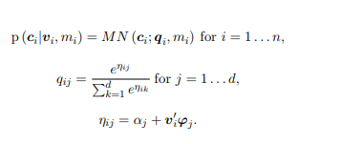
DMR model
Let ci be a vector of counts in d categories, summing to mi = Σ j cij (counts of word or phrase)
let vi be a pv-vector of covariates on observation i = 1 . . . n. (attributes : author, date, etc)
An econometrician confronted with modeling counts data may first consider using a multinomial logistic regression:

Slide 8
multinomial can be decomposed into independent Poissons conditional
Motivated by this decomposition, Taddy (2015) develops the distributed multinomial regression (DMR), a parallel (independent) Poisson plug-in approximation to the multinomial

Slide 9
so on so forth
The parameters for each category j can then be estimated independently with negative log likelihood
Approximation removes the communication bottleneck of re-computing summation term and allows for fast and scalable distributed estimation.
Taddy (2013, 2015) uses the DMR to estimate a low dimensional sufficient reduction projection

Slide 10
Example
Suppose viy is the first element of vi , which is available in a subsample, but needs to be predicted for other subsamples.
The first step would be to run a multinomial inverse regression of word counts on the covariates v in the training sample to estimate ϕ
Second, estimate a forward regression (linear or higher order)
Finally, the forward regression can be used to predict viy using text and the remaining covariates vi,−y.(Ziy is the projection of phrase count in the direction of Viy)

Slide 11
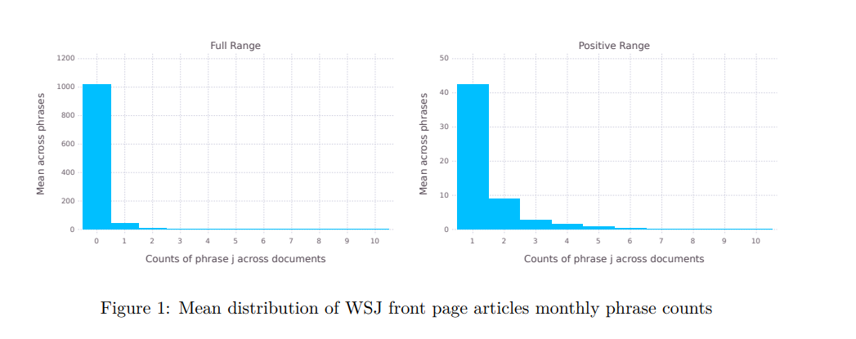
HDMR model
the Poisson is a poor description of word counts cij
Left: mass zero point Right: truncate to approximate

Slide 12
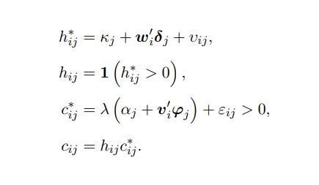
replace the independent Poissons with a two part hurdle model for counts cij , which we label the hurdle distributed multiple regression (HDMR):
Two choices : include or exclude word j
Only observe included words

Slide 13
So on so force again
Let π0 denote the discrete density for zeros
Natural choices for π0 are the probit and logit binary choice models. Let P + denote the model for positive counts, so that conditional on inclusion,
Joint density:

Slide 14
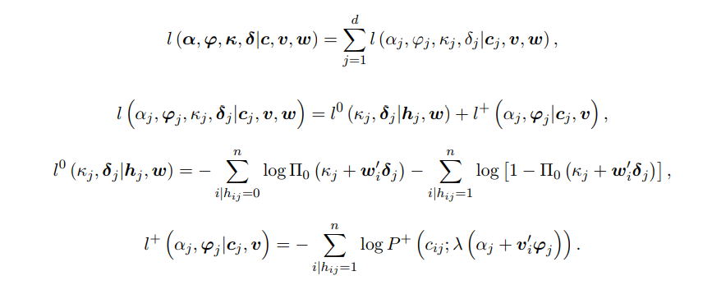
Negative log likelihood:

Slide 15
Exclusion is the only source of zero counts
κj and δj , only depend on word j indicators hj and on the covariates w
αj and ϕj , only depend on positive word counts cj > 0
HDMR therefore allows one to estimate text selection in Big Data applications of previously impossible scale, by distributing computation across categories and across the two parts of the selection model

Slide 16
Regularization
N << P
the feature space (words) is much larger than the number of observations
the penalty is normalized by the number of such documents n+

Slide 17
Projection(recover low dimension text indices that track variables of interest)
Inverse regression for prediction
Predict Viy using text and the remaining covariates

Slide 18
Application
He, Kelly, and Manela (2017) find a simple two-factor model that includes the excess stock market return and the aggregate capital ratio of major financial intermediaries can explain cross-sectional variation in expected returns across a wide array of asset classes.
Conclusions are limited
Calculations are precluded prior to 1970
Conjecture: publication catering to investors (text that appears on the front page of the Wall Street Journal would be informative about the aggregate state of the intermediary sector)

Slide 19
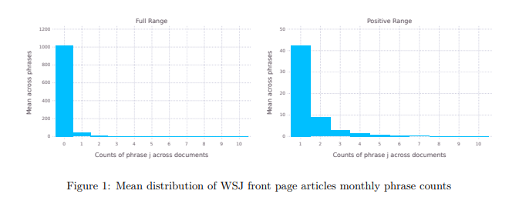
Data
Wall Street Journal from July 1926 to February 2016

Slide 20
covariates
match this data with the monthly intermediary capital ratio icrt (prediction target ) of He, Kelly, and Manela
the log price over annualized dividend ratio pdt
log realized variance rvt
monthly average number of pages in section A, biznewspres (backfill the ICR as far back as possible)

Slide 21
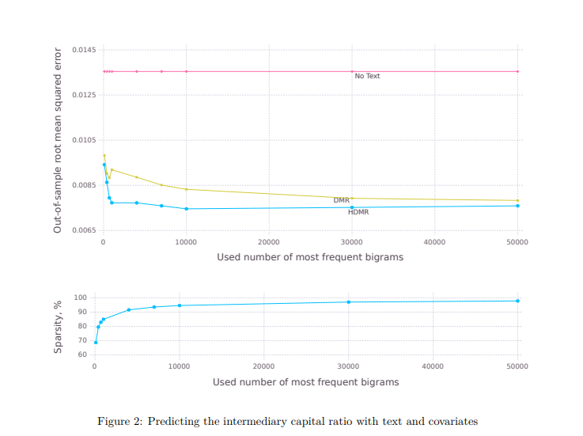
Clean the data (omit words or phrases that rarely appear in the sample)
Compare MSE from 10-fold cross validation exercise

Slide 22
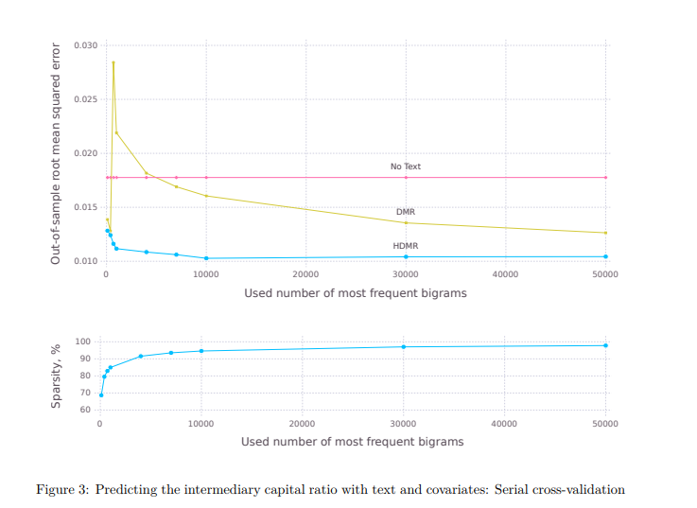
Using serial variant of cross-validation (different time lead to different prediction)

Slide 23
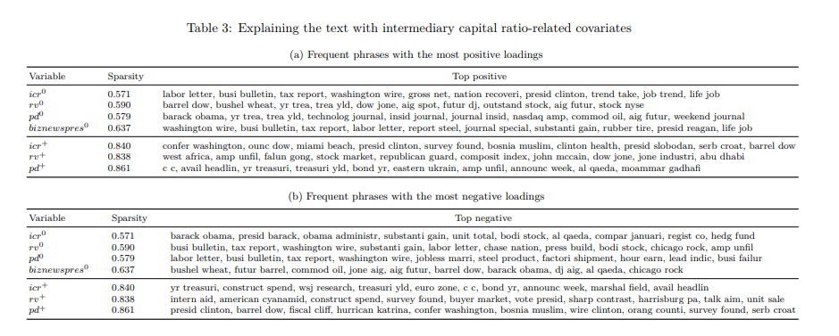
Icr: capital ratio rv: realized variance pd: price over annualized dividend ratio biznewspres: monthly average number of pages in section A
Loadings of the variables

Slide 24
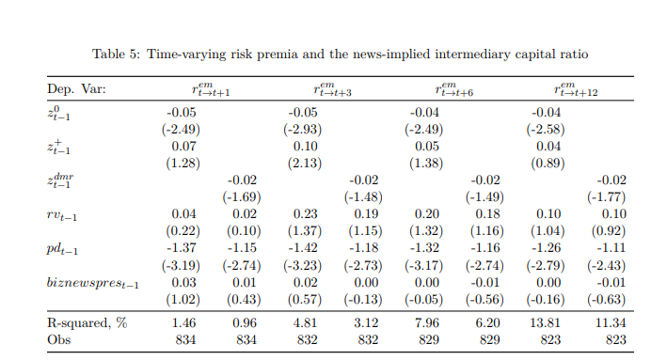
regress future stock market excess returns on lagged sufficient reduction projections Z0 t−1 , Z+ t−1 , and covariates rvt−1, pdt−1 and biznewsprest−1
projection z0 t−1 is a strong predictor of future market returns,

Slide 25
Conclusion
Develop high-dimensional model that fit sparse count data
especially useful in cases where the cover/no-cover choice is separate or more interesting than the coverage quantity choice

Slide 26
Discussions
New method?
Improvement? (advantage increases with sparsity of data)
Other methods

